Slide 1

Retail Sales And Inventory Intelligence

Slide 2
Problem Statement:
Design and implement a comprehensive data analysis solution for a retail company
that sells mobile phones and laptops. The company operates multiple stores and
wants to analyze its end-to-end operations—from order processing to inventory
management and sales performance—across regions, stores, products, and staff. The
company’s management seeks to extract insights that can improve sales strategies,
identify top-selling products, understand customer preferences, optimize inventory,
and monitor staff performance.

Slide 3
Business Use Cases:
Identify top-selling brands by region and store.
Evaluate staff performance based on total sales handled.
Track customer orders and their fulfillment status.
Identify the most profitable product categories.
Analyze stock levels across stores to optimize inventory.
Understand order trends across time (daily, weekly, monthly).
Discover customer concentration and demographics.
Segment customers based on order volume and frequency.
Predict high-demand products during upcoming months.
Monitor delayed shipments vs. required delivery dates.

Slide 4
Approach:
Excel – Data Preprocessing
Load raw data into Excel.
Clean up inconsistencies (null values, date formats, duplicate entries).
Normalize Phase specific fields (e.g., product and category names).
Conduct exploratory data summaries (pivot tables, filters).
Save clean datasets for import into SQL.

Slide 5
Power BI – Dashboard Creation
Create visuals for:
KPIs: Total Sales, Total Orders, Customer Count
Bar Charts: Sales by Category, Staff, Store
Maps: Regional Sales Distribution
Line Charts: Sales Over Time
Matrix Tables: Orders by Staff and Customer
Apply slicers for Date, Region, Store, Category.
Enable drill-down features for detailed analysis.
Readiness for predictive analytics

Slide 6
Results:
Cleaned, structured database for analytics
Interactive dashboard showing all KPIs and metrics
Insights into sales trends, inventory, staff, and customer behavior

Slide 7
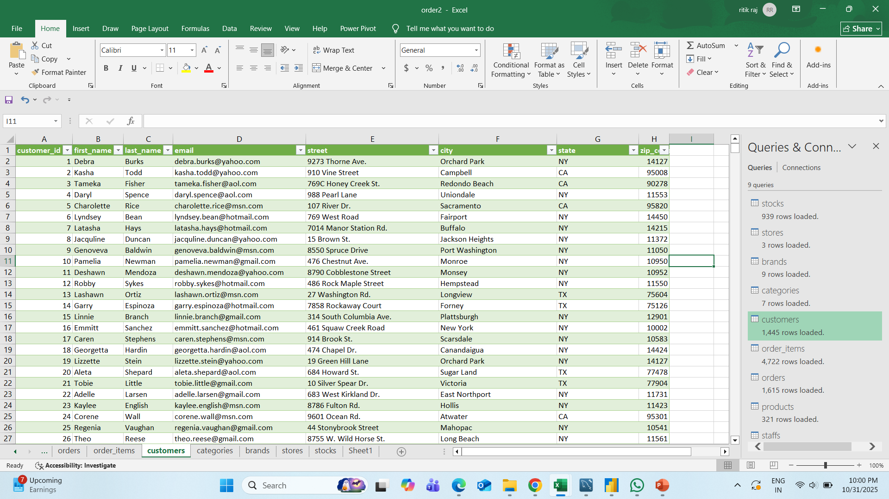
Excel Workbook

Slide 8
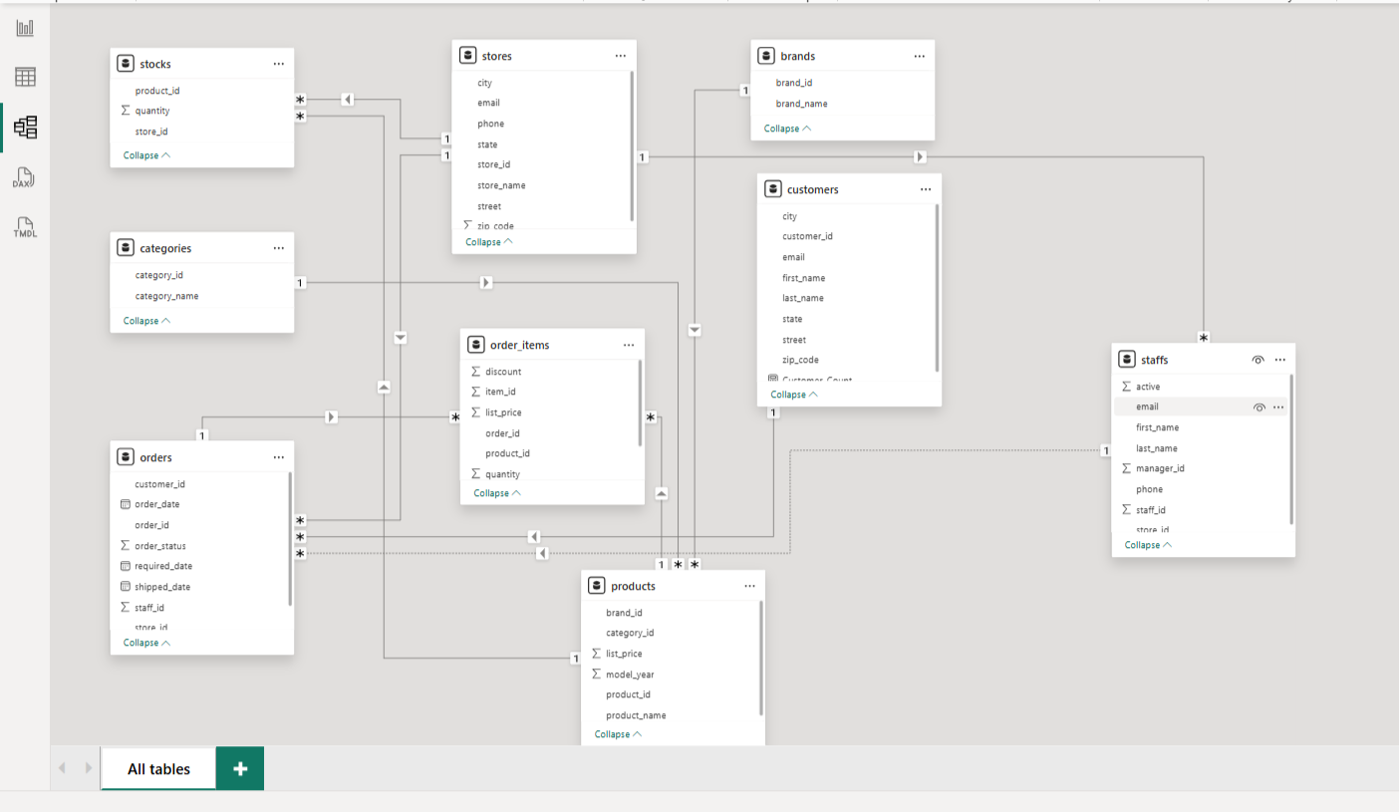
Data Modeling

Slide 9
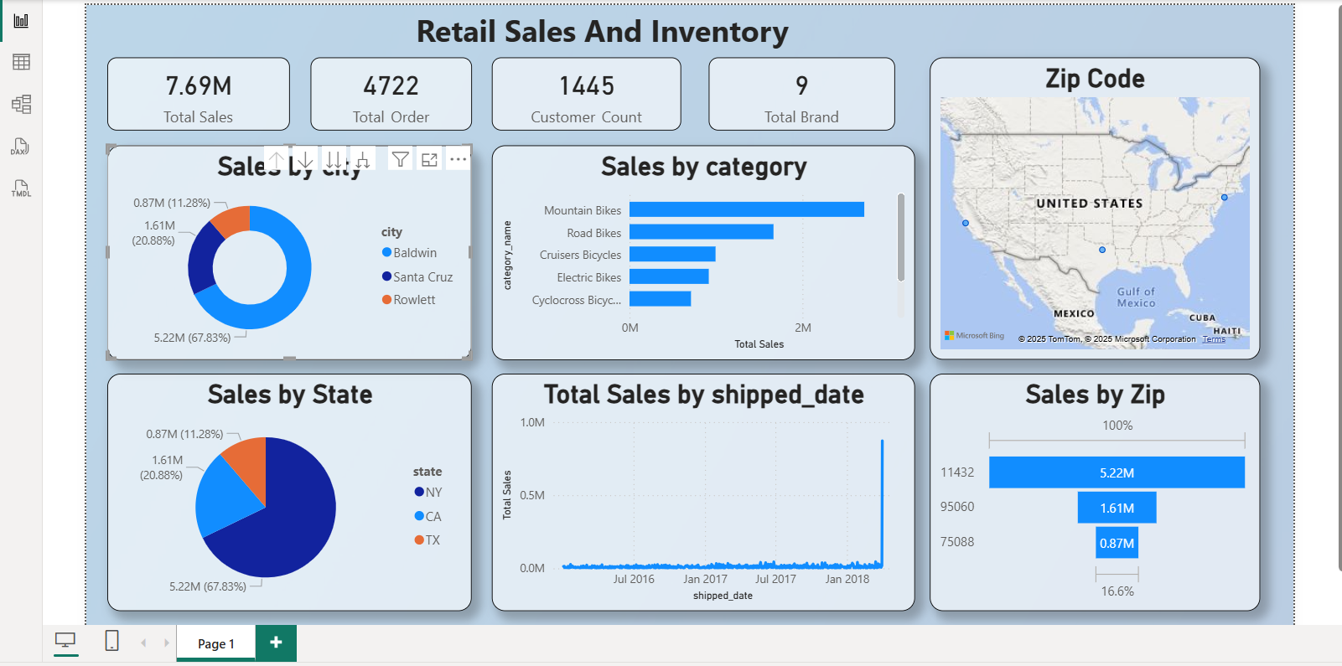
Final Dashboard

Slide 10
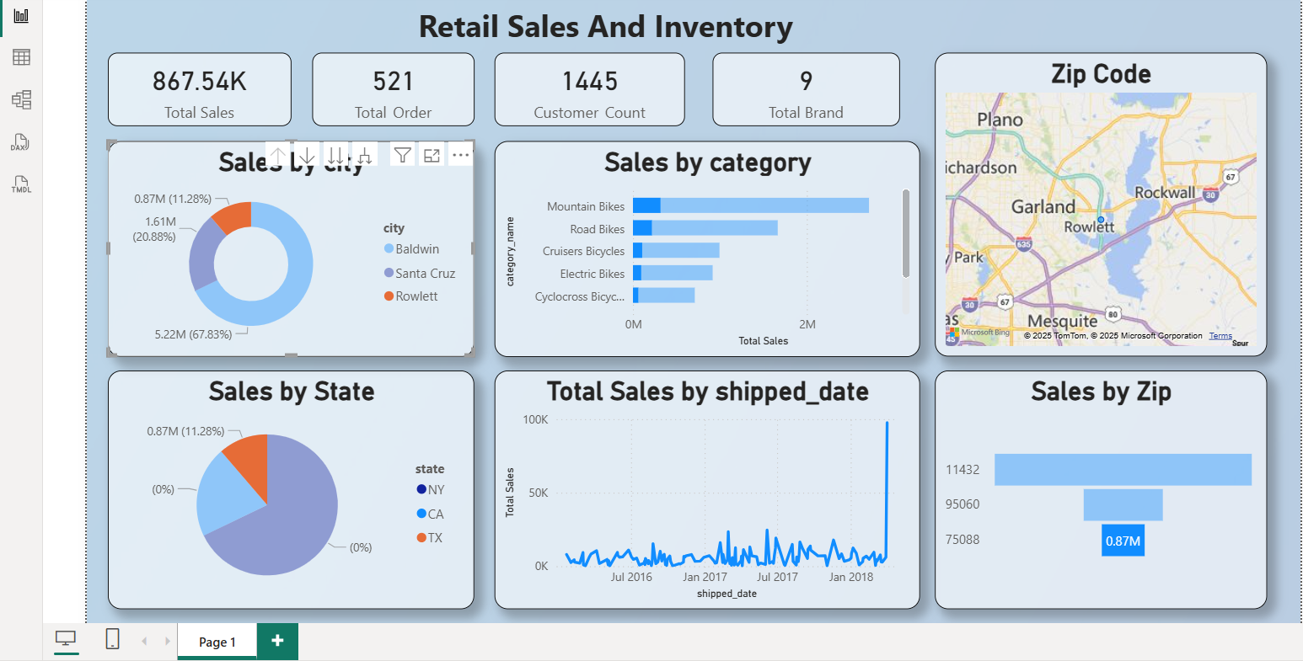
Sales By City

Slide 11
Thank You

